Slide 1
ECE 260C, Spring 2025 Placement
Andrew B. Kahng
Thanks to: Andrew Kennings, Mingyu Woo, SangGi Do, Nima Darav
Kahng ECE 260C SP25

Slide 2
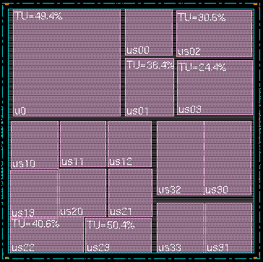
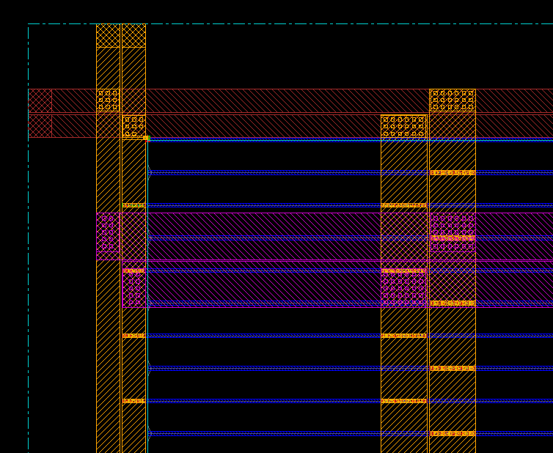
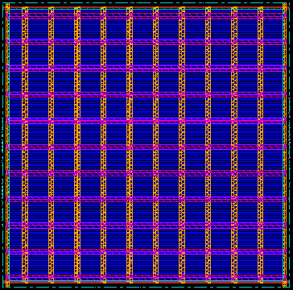
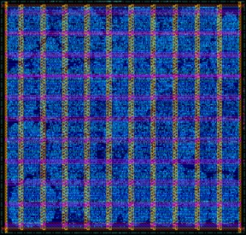
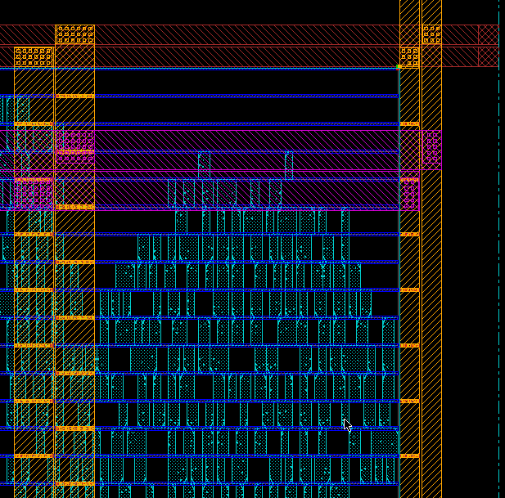
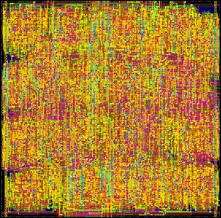
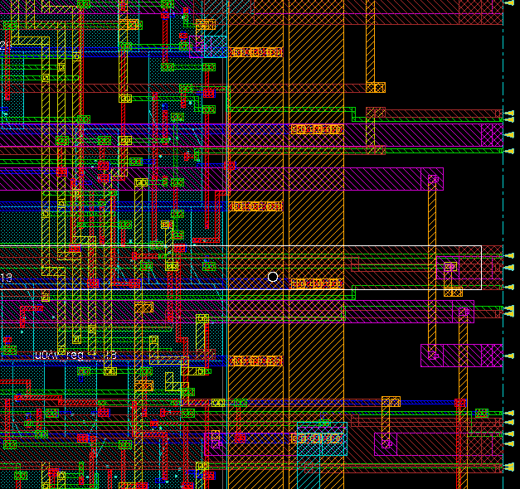
Physical Design Flow Pictures (old ECE 260B slide)
Floorplanning
Powerplanning
Placement
Routing

Slide 3
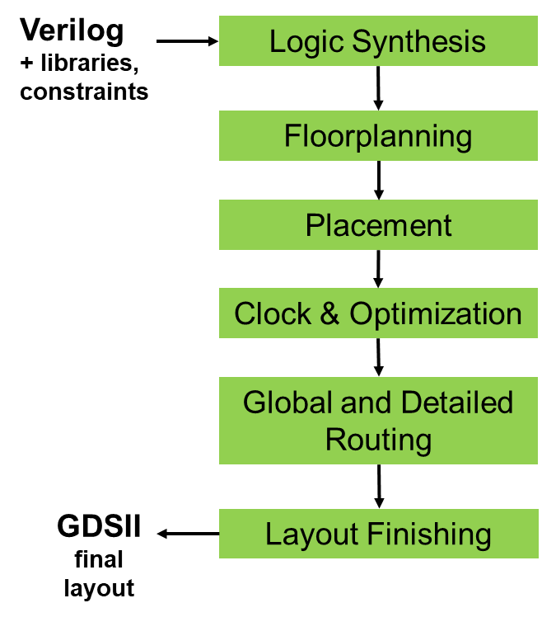
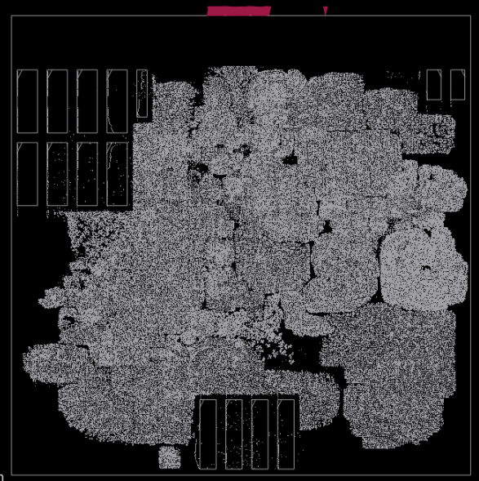
Global Placement
Kahng ECE 260C SP25
Notes:
THIS placement. There are around 300 thousand standard cells in this picture. The global placement gets things roughly into the right places.

Slide 4
GPL
Kahng ECE 260C SP25

Slide 5
RePlAce: Advancing Solution Quality and Routability Validation in Global Placement
Chung-Kuan Cheng, Andrew B. Kahng, Ilgweon Kang and Lutong Wang
(based on slides from Ilgweon Kang’s Ph.D. defense)
paper
Kahng ECE 260C SP25

Slide 6
Placement Overview
Placement
Determines the locations of standard cells and/or logic elements while addressing optimization objectives
Highly important physical design step in integrated circuit (IC) design flow
Directly impacts on timing closure, die utilization, routability, design turnaround time (TAT) → operating frequency, yield, power consumption, cost
Placement instances
Hypergraph G = (V, E)
V:= a set of vertices, i.e., standard cells and macros
E:= a set of hyperedges, i.e., nets
Placement solution v = (x, y), X- and Y-coordinates of all placeable vertices
legal solution?
Every instance should be settled in the placement region.
Every standard cell should be spaced within predefined rows.
No overlap is allowed between instances including both standard cells and macros.
Kahng ECE 260C SP25
A. B. Kahng, J. Lienig, I. L. Markov and J. Hu, VLSI Physical Design: From Graph Partitioning to Timing Closure, Springer, 2011

Slide 7

Problem Formulation
Placement Objective Function f(v)
ePlace: Electrostatics-based global-smooth density function
$$\min_{v}{f(x,y)}=W\left(x,y\right)+\sum_{b}{𝒱_{b}}D_{b}(x,y)$$
Placement Instance
Electrostatic System
Cell Instance
Electric Particles
Cell Coordinate & Dim.
Charge Coordinate & Dim.
Cell Area (A_{i})
Charge Quantity (q_{i})
Even Density Distr.
Min. Potential Energy
Kahng ECE 260C SP25
[13] J. Lu, “Analytic VLSI Placement Using Electrostatic Analogy”, Ph.D. Dissertation, UC San Diego, CA, 2014.

Slide 8
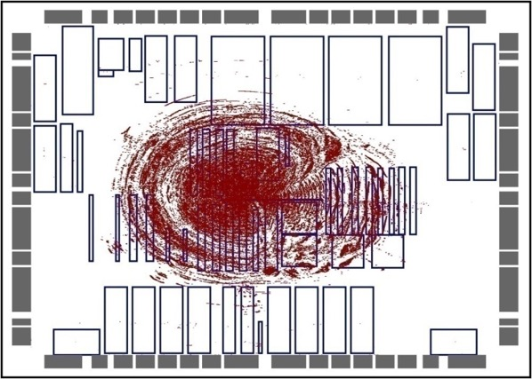
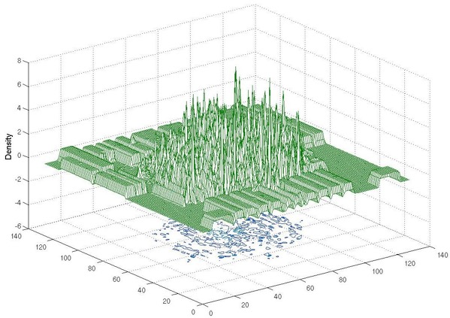
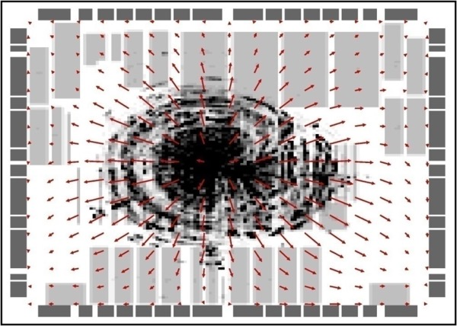
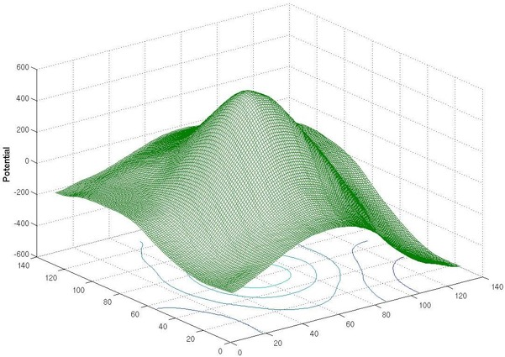
ePlace: In Each Iteration
sol. v
ρ(x, y)
cell & macro distr.
charge density distr.
E(x, y)
ψ(x, y)
electric field distr.
electric potential distr.
Kahng ECE 260C SP25
J. Lu, “Analytic VLSI Placement Using Electrostatic Analogy”, Ph.D. Dissertation, UC San Diego, CA, 2014.

Slide 9
RePlAce
Unified placement engine which solves multiple classes of academic benchmarks (mixed-size, fixed-macros, routability-driven, etc.
Local Lagrange multiplier
Enables local smoothing w/awareness of local over-demanded bins
Meta parameter tuning
Adjust step size of numerical method
Routability optimization
Simple but effective metal layer-aware superlinear cell inflation
Differences from the previous ePlace 2.0
Routability optimization techniques
Code optimizations for ~4X speedups
Various improvements to placement mechanisms
E.g., macro legalization using annealing; amount of rollback after fixing macro; handling of overflows; bin size determination and local smoothing; …
Kahng ECE 260C SP25

Slide 10
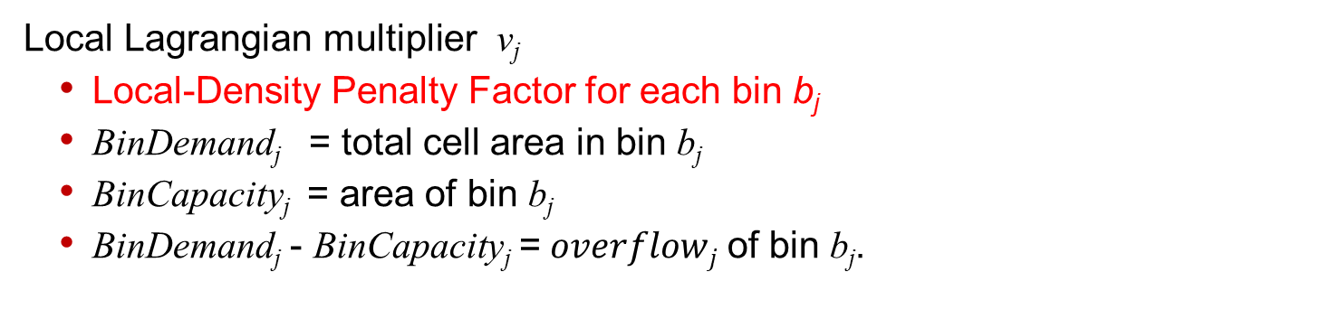
RePlAce: Constraint-Driven Placement
Local Lagrangian multiplier ν_{j}
Local-Density Penalty Factor for each bin b_{j}
BinDemand_{j} = total cell area in bin b_{j}
BinCapacity_{j} = area of bin b_{j}
BinDemand_{j} - BinCapacity_{j} =$overflowj$ of bin b_{j}.
[ePlace]
[RePlAce with Constraint-Driven]
Kahng ECE 260C SP25

Slide 11
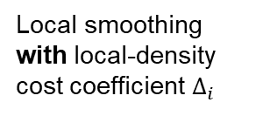
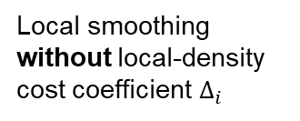
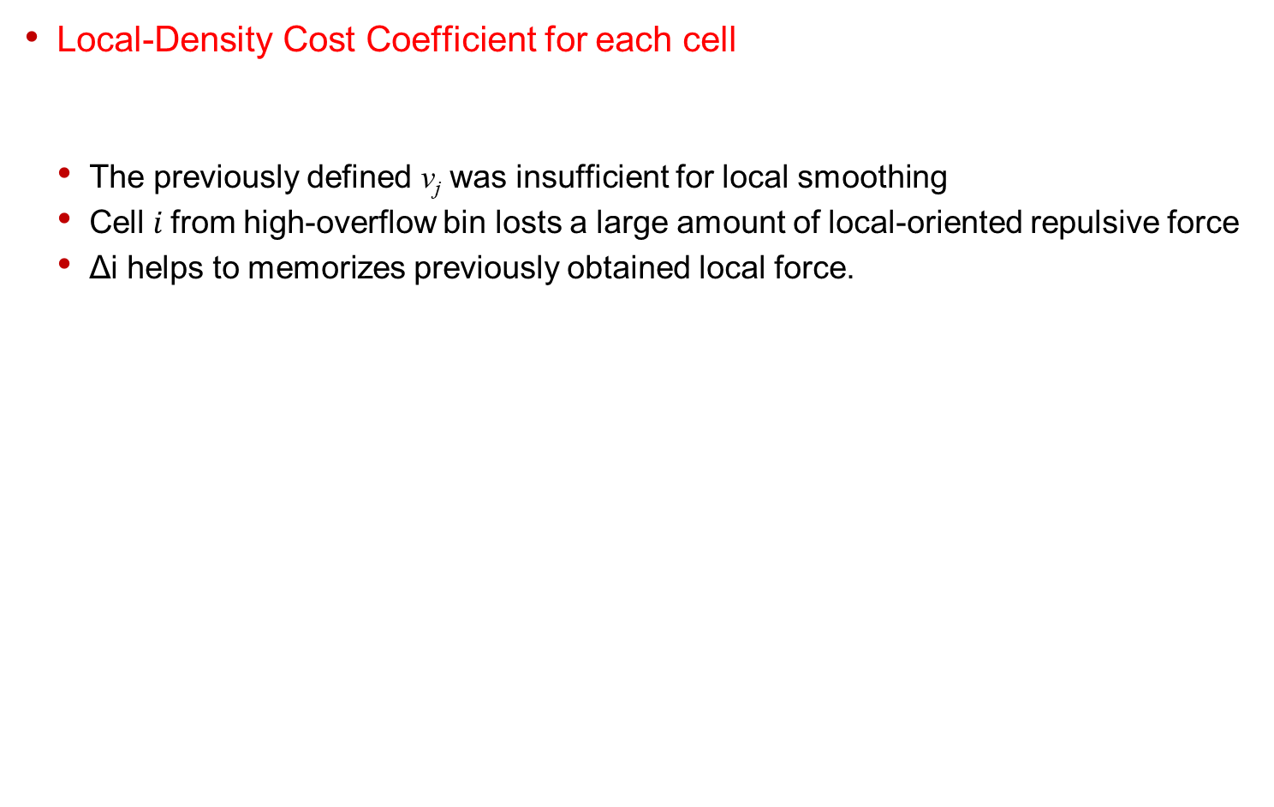
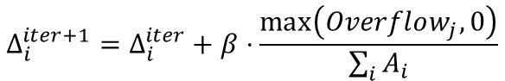
RePlAce: Constraint-Driven Placement
Local-Density Cost Coefficient for each cell
The previously defined ν_{j} was insufficient for local smoothing
Cell$i$from high-overflow bin losts a large amount of local-oriented repulsive force
Δi helps to memorizes previously obtained local force.
$$Δ_{i}^{iter+1}=Δ_{i}^{iter}+β⋅\frac{\max\left(Overflow_{j}, 0\right)}{\sum_{i}{A_{i}}}$$
Local smoothing without local-density cost coefficient $Δ_{i}$
Local smoothing with local-density cost coefficient $Δ_{i}$
Kahng ECE 260C SP25

Slide 12
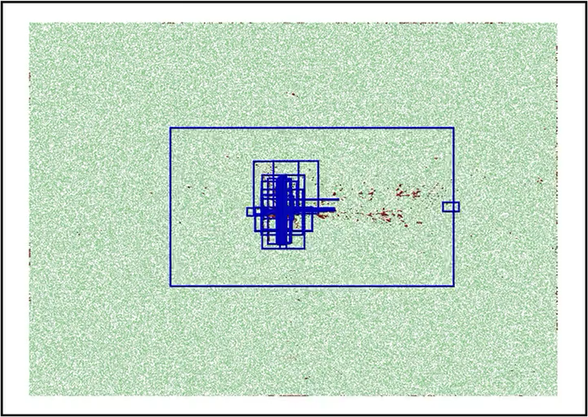
RePlAce: Constraint-Driven Placement
Global placement animation with local Lagrangian multiplier
NEWBLUE1, [RePlAce with local Lagrangian multiplier, i.e., constraint-driven placement]
HPWL = 5.60E+7, #Iter = 762 (623+139), runtime = 9.9 min, target density = 100%
Comparison: ePlace 2.0 with local Lagrangian multiplier
HPWL = 5.71E+7, #Iter = 1078 (609 + 469), runtime = 42 min, target density = 100%
Kahng ECE 260C SP25

Slide 13
RePlAce: Dynamic Step Size
General Idea of Dynamic Step Size
(a)
(b)
(c)
Kahng ECE 260C SP25

Slide 14
RePlAce: Improved Dynamic Step Size
Methodology to capture “transition points” on HPWL curve.
▲ HPWL curve of ADAPTEC1 (MMS) from the trial placement procedure and the estimated transition points (TPs)
▲ Flowchart of trial placement procedure. The red rectangle indicates nonlinear optimization using Nesterov’s method. The actual placement procedure follows this tGP procedure.
Kahng ECE 260C SP25

Slide 15
RePlAce: Improved Dynamic Step Size
Solution quality in terms of the final HPWL
ePlace vs. RePlAce-ds (ADAPTEC1)
RePlAce-ds achieves a dominating runtime and solution quality (red square)
Below [0.95, 1.003], e.g., [0.95, 1.002], [0.95, 1.001], etc., runs did not converge
Kahng ECE 260C SP25

Slide 16
RePlAce: Routability-Driven Placement
Simple but effective routability optimization
A layer-aware cell inflation technique
Integrate the official global router NCTU-GR [17] of the DAC-2012 [18] and ICCAD-2012 [19] benchmark suites for congestion estimation.
Superlinear cell inflation technique to mitigate global routing congestion during global placement.
We further include a post-placement optimization by [20]
Following the strategy of recent leading works [21] [22]
[17] NCTU-GR, http://people.cs.nctu.edu.tw/˜whliu/NCTU-GR.htm
[18] N. Viswanathan, C. J. Alpert, C. N. Sze, Z. Li and Y. Wei, “The DAC 2012 Routability-driven Placement Contest and Benchmark Suite”, Proc. DAC, 2012, pp. 774-782.
[19] N. Viswanathan, C. J. Alpert, C. N. Sze, Z. Li and Y. Wei, “ICCAD-2012 CAD Contest in Design Hierarchy Aware Routability-Driven Placement and Benchmark Suite”, Proc. ICCAD, 2012, pp. 345-348.
[20] W.-H. Liu, C.-K. Koh and Y.-L. Li, “Optimization of Placement Solutions for Routability”, Proc. DAC, 2013, pp. 1-9.
[21] X. He, T. Huang, L. Xiao, H. Tian and E. F. Y. Young, “Ripple: A Robust and Effective Routability-Driven Placer”, IEEE Trans. on CAD 32(10) (2013), pp. 1546-1556.
[22] X. He, Y. Wang, Y. Guo and E. F. Y. Young, “Ripple 2.0: Improved Movement of Cells in Routability-Driven Placement”, ACM Trans. on DAES 22(1) (2016), pp. 10:1-10:26.
Kahng ECE 260C SP25

Slide 17
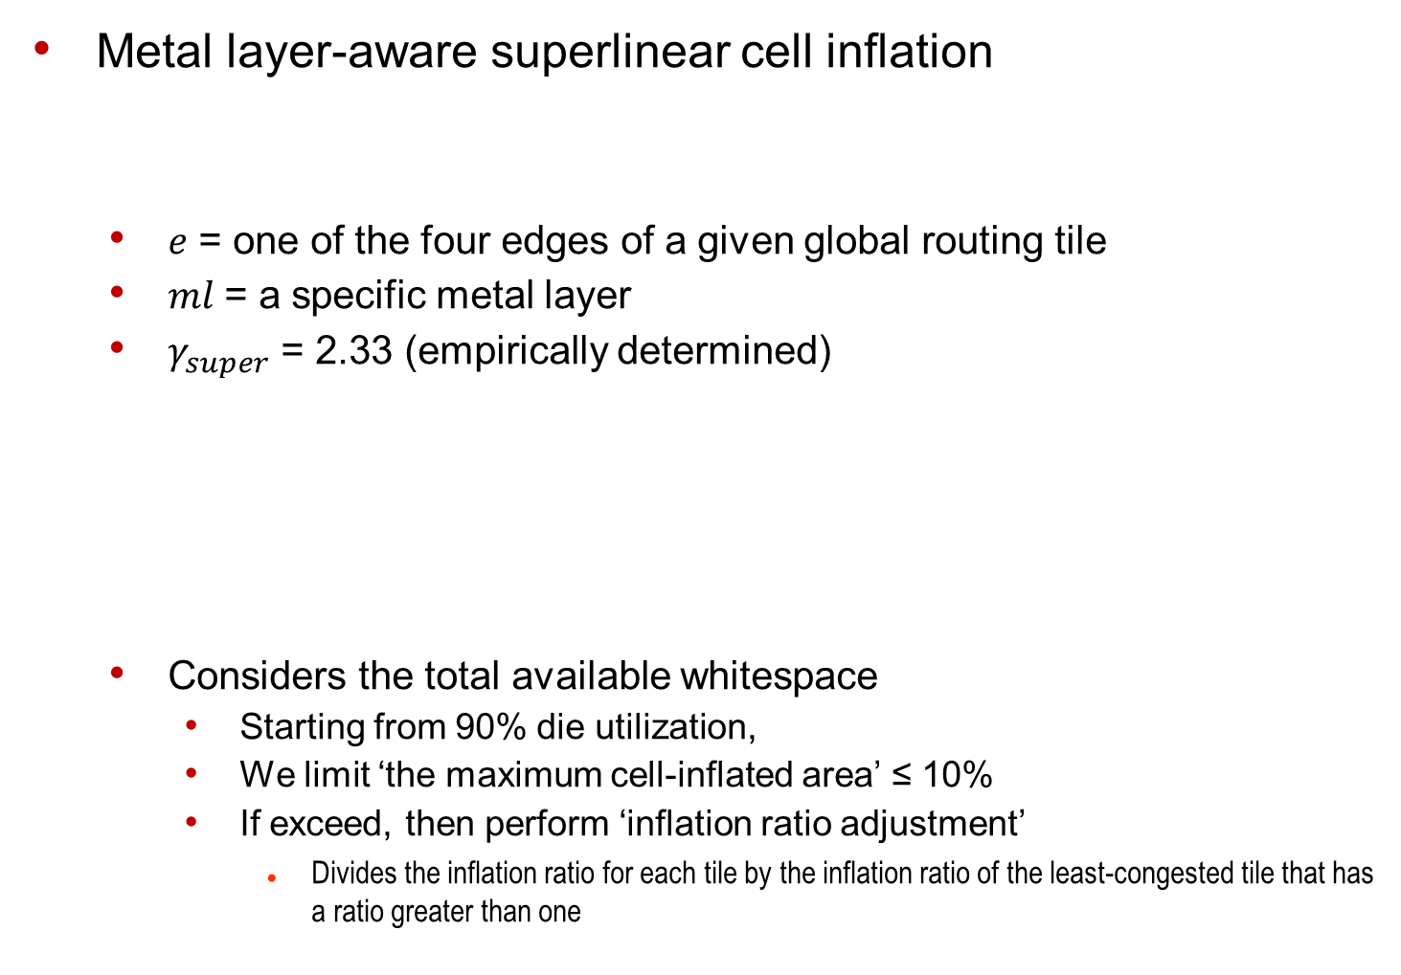
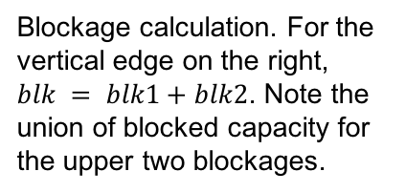
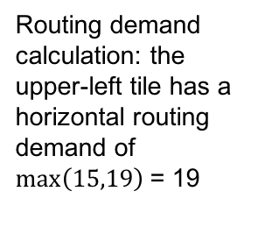
RePlAce: Routability-Driven Placement
Metal layer-aware superlinear cell inflation
$e$ = one of the four edges of a given global routing tile
$ml$= a specific metal layer
$γ_{super}$ = 2.33 (empirically determined)
Considers the total available whitespace
Starting from 90% die utilization,
We limit ‘the maximum cell-inflated area’ ≤ 10%
If exceed, then perform ‘inflation ratio adjustment’
Divides the inflation ratio for each tile by the inflation ratio of the least-congested tile that has a ratio greater than one
▲
Blockage calculation. For the vertical edge on the right,
$blk = blk1+blk2$. Note the union of blocked capacity for the upper two blockages.
▲
Routing demand calculation: the upper-left tile has a horizontal routing demand of $\max\left(15,19\right)$= 19
Kahng ECE 260C SP25

Slide 18
RePlAce: Routability-Driven Placement
IEEE Trans. on CAD paper: routability optimization flow
Uses the detailed placer from NTUplace3
T.-C. Chen, Z.-W. Jiang, T.-C. Hsu, H.-C. Chen and Y.-W. Chang, “NTUplace3: An Analytical Placer for Large-Scale Mixed-Size Designs with Preplaced Blocks and Density Constraints”, IEEE Trans. on CAD 27(7) (2008), pp. 1228-1240.
Kahng ECE 260C SP25

Slide 19
RePlAce: Routability-Driven Placement
Global routing overflow (SUPERBLUE12) during routability-driven global placement procedure
Kahng ECE 260C SP25

Slide 20
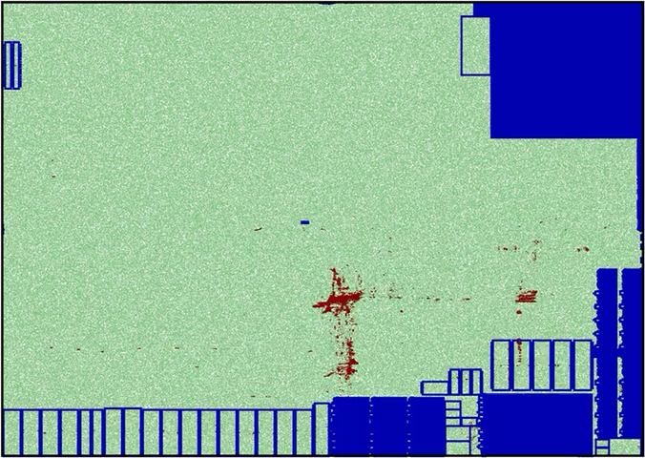
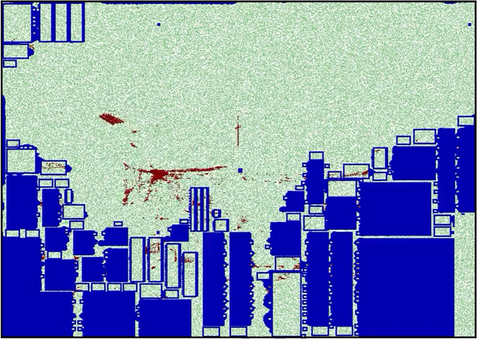
RePlAce: Routability-Driven Placement
Global placement animation with our routability optimization
Keeps the inflated cell size by the end of global placement
Red-cell zone is keep growing along with the routability optimization
SUPERBLUE12 (DAC-2012)
The initial RC value = 211.73
The final RC value = 102.43
SUPERBLUE18 (ICCAD-2012)
The initial RC value = 135.23
The final RC value = 102.10
Kahng ECE 260C SP25

Slide 21
RePlAce (2019) Summary
Advancing solution quality and routability validation in GPL
Local density function
Local smoothing comprehending local over-demanded bins
Improved dynamic step size adaptation
Routability optimization
Simple but effective metal layer-aware superlinear cell inflation technique
Superior solution quality for range of problem types
Standard cell placement: average HPWL reduction of 2.00% over best previous ISPD benchmark results
Mixed-size placement: average HPWL reduction of 2.73% over the best previous MMS benchmark results
Routability-driven placement: average 8.50% to 9.59% scaled HPWL reduction over previous leading academic placers for DAC-2012 and ICCAD-2012 benchmark suites
Notes
Formulation is here (calculate demand / capacity) and here
Dynamic step size updating is here
Entry point for routability-driven is here
Calculation of cell inflation for routability-driven placement is here and here
Kahng ECE 260C SP25

Slide 22
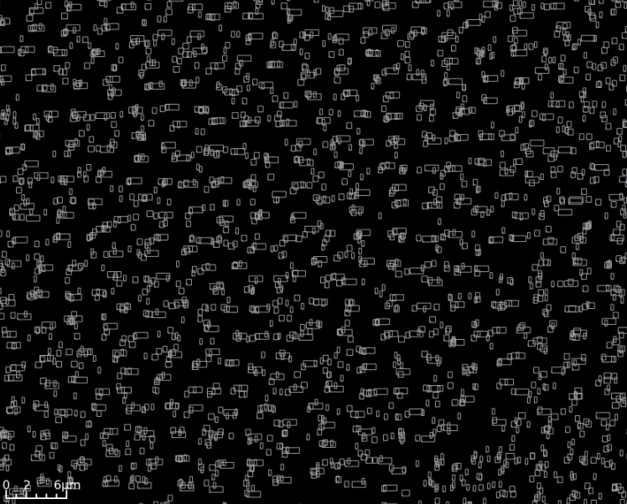
Global Placement Zoom-In
Kahng ECE 260C SP25
Notes:
And, if we zoom in to the global placement, you can see that cells are definitely not placed into nice rows. What’s more, even at this stage, it’s already pretty obvious where there are electrical or timing problems in this layout that we’re creating. For instance, a high-fanout net with 80 pins is going to have terrible delays and transition times at its sinks, unless we add some buffers to break up that high fanout. Or, a long net that delivers a signal from driver to a far-away receiver will need buffering as well. So, OpenROAD performs OPTIMIZATION at this juncture, including inserting buffers or upsizing weak drivers.

Slide 23
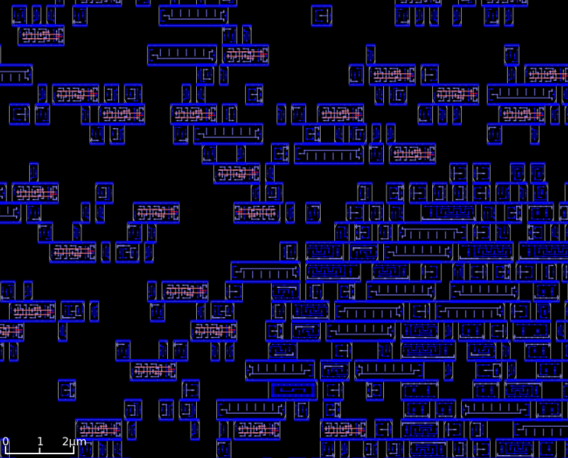
(Legalized) Detailed Placement Zoom-In
Kahng ECE 260C SP25
Notes:
After this, the standard-cells are LEGALIZED into rows, and users have the option to call further DETAILED PLACEMENT optimizations of wirelength or routability while maintaining the legal, row-based nature of the placement.

Slide 24
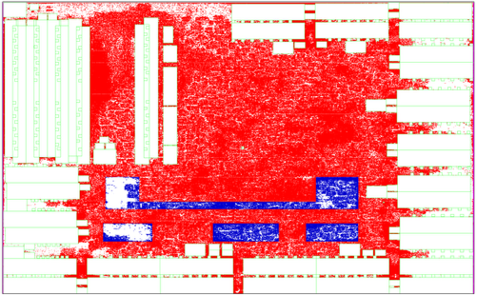
Region constraints
Cells assigned to a region have to be placed inside the boundary of the region.
mgc_superblue16_a
Zoomed area containing a region constraint
Thanks: Nima Darav, AMD
Notes:
As the size of transistors shrinks, more complicated constraints are imposed.
Some important modern technology constraints considered in this proposal are:
Region constraints which assign some cells to specific region. Cells assigned to a region have to be placed inside the boundary of the region.

Slide 25
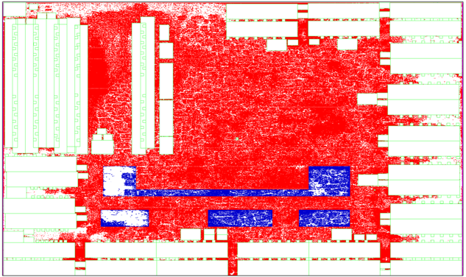
Fence region constraints
Cells assigned to a fence region have to be placed inside the boundary of the region while other cells need to be placed outside.
Zoomed area
mgc_superblue16_a
Thanks: Nima Darav, AMD
Notes:
Cells assigned to a fence region have to be placed inside the boundary of the region while other cells have to be placed outside of the boundary.
Violating fence region constraints makes the placement unacceptable and these constraints are generally considered as hard constraints.

Slide 26
Edge spacing constraints
Prone to pin access and short problems
Two cells are too close to each other
Thanks: Nima Darav, AMD
Notes:
Edge spacing rules are a minimum space between two or more objects. In this example, the shown two cells are too close to each other, therefore, the pins in pink are prone to pin access or short problems

Slide 27
DPL
Kahng ECE 260C SP25

Slide 28
Legalization and detailed placement
Global placement must be legalized
Cell locations typically do not align with power rails
Small cell overlaps due to incremental changes, such as cell resizing or buffer insertion
Legalization seeks to find legal, non-overlapping placements for all placeable modules
Legalization can be improved by detailed placement techniques, such as
Swapping neighboring cells to reduce wirelength
Sliding cells to unused space
Software implementations of legalization and detailed placement are often bundled (dpl)
Thanks: Sang-Gi Do, Samsung

Slide 29
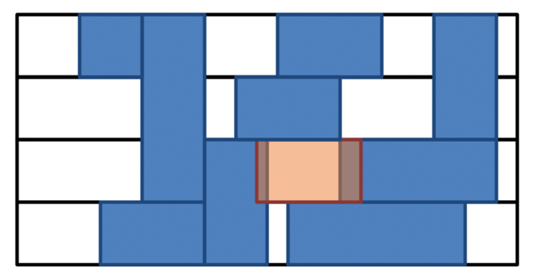
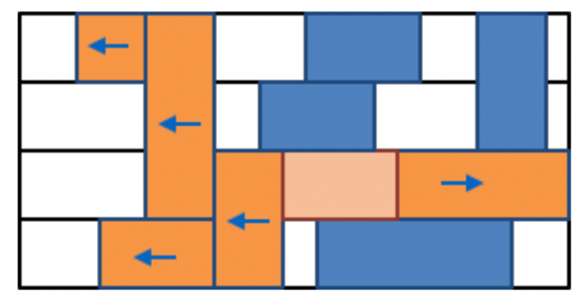
Mixed-height standard cell legalization
Legalization: seek legal placement + remove overlaps
Mixed-height standard cells: standard cells that span different row heights ← single/double/triple/quadruple
Mixed-height standard cell legalization is challenging
Potential overlaps in vertical (+ horizontal) directions
Horizontal movement of a multi-height cell disrupts placement across all rows it overlaps
Presence of fence regions aggravate the problem
Thanks: Sang-Gi Do, Samsung

Slide 30
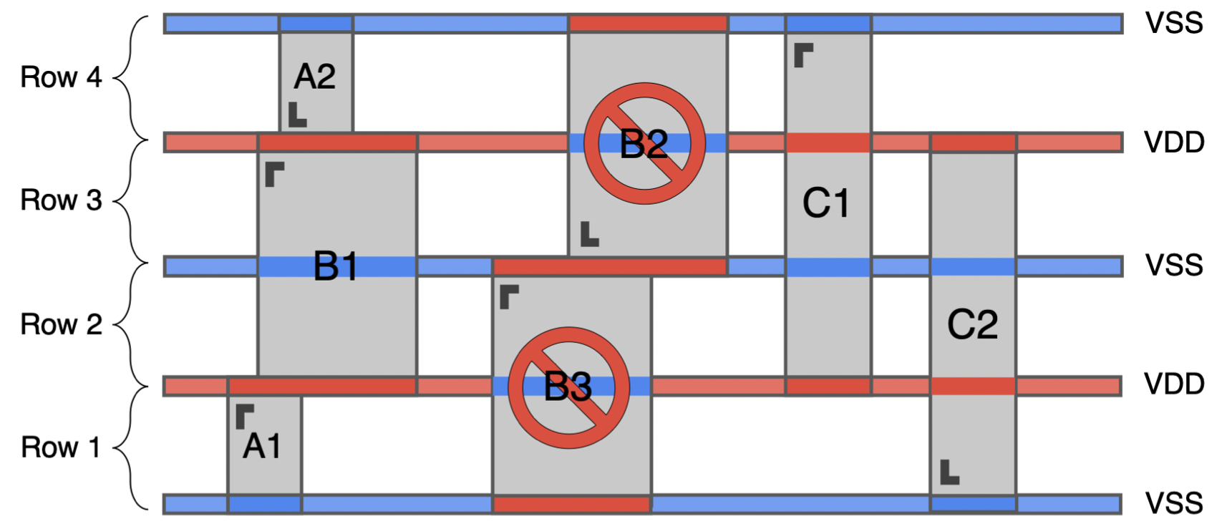
An example of power rails violation
Red bars: power (VDD); blue bars: ground (VSS)
A1, A2: single height standard cells; B1, B2: double height standard cells; C1, C2: triple height standard cells
B2 and B3 violate power rails alignment
Thanks: Sang-Gi Do, Samsung

Slide 31
Overall framework in dpl
Fence region-aware (FRA) BFS algorithm (paper)
Find nearest available position
Shift peripheral cells
Cell arrangement
Local cell shifting
Corner weight move
Multi-height legalization: fence region-aware BFS
Move cells towards corner of fence region
Global placement result
Pre-legalization
Multi-height legalization
Refinement
Legalize cells that violate fence regions
Cell move
Cell swap
Greedy refinement
Thanks: Sang-Gi Do, Samsung

Slide 32
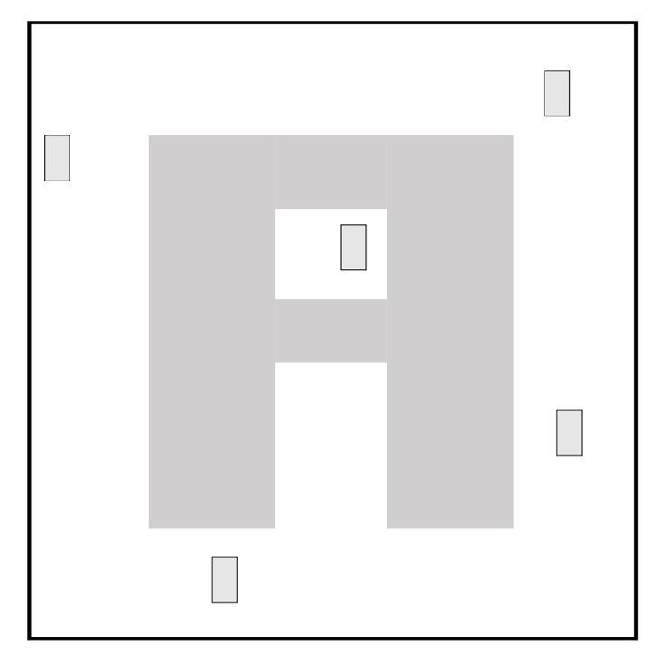
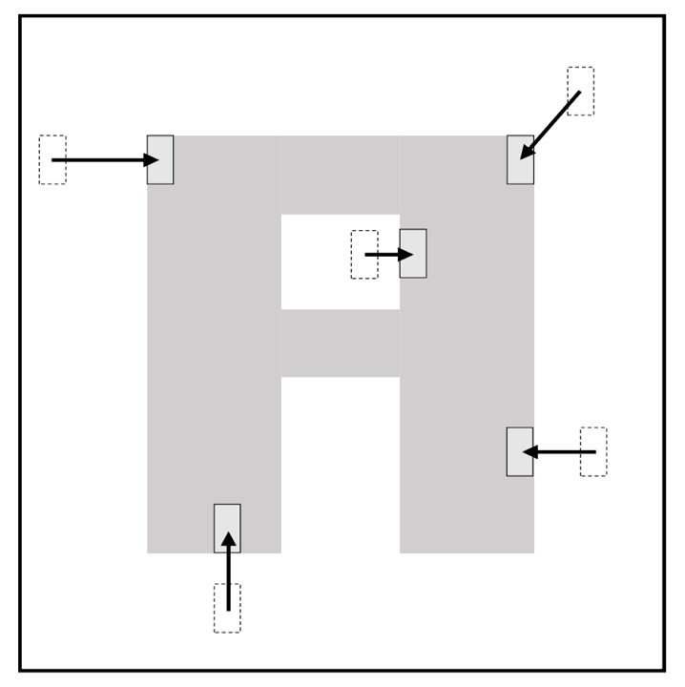
Pre-legalization – an example
Grey cells outside fence region are pushed into the fence region
Fence region
Before pre-legalization
After pre-legalization
Thanks: Sang-Gi Do, Samsung

Slide 33
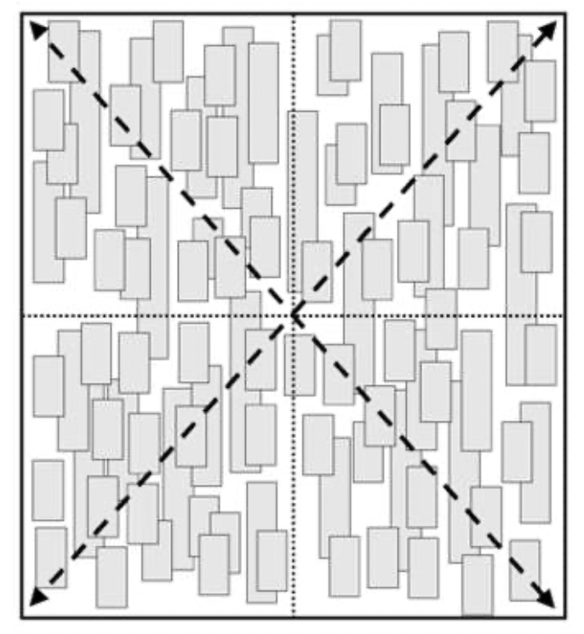
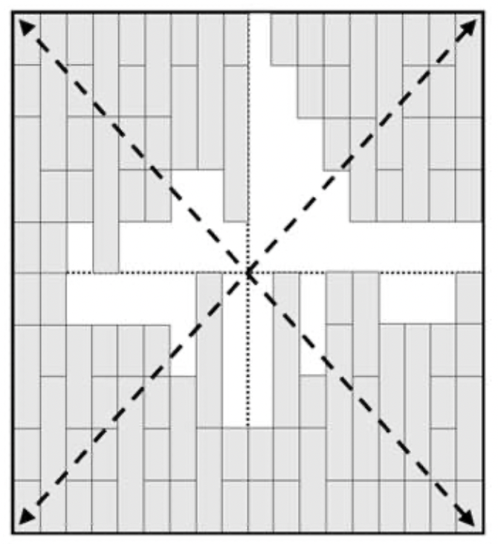
Corner weight move – an example
Push standard cells towards the corners of the fence region
Before corner weight moves
After corner weight moves
Thanks: Sang-Gi Do, Samsung

Slide 34
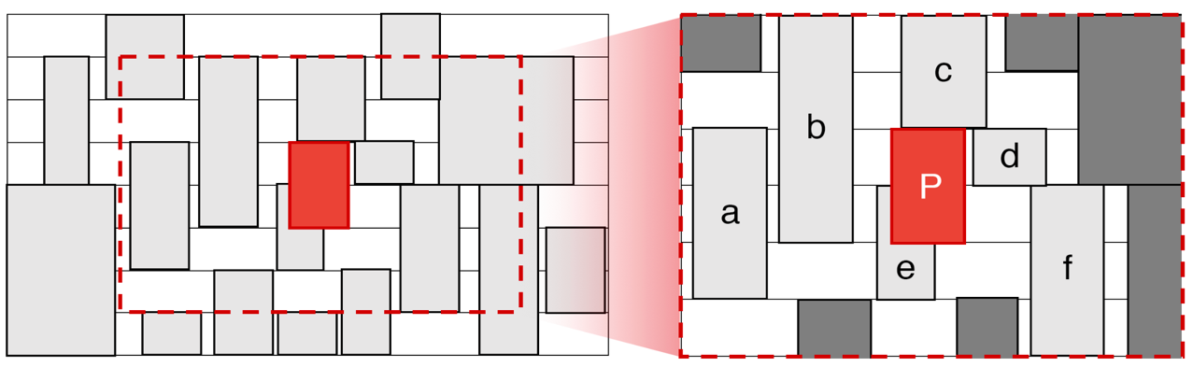
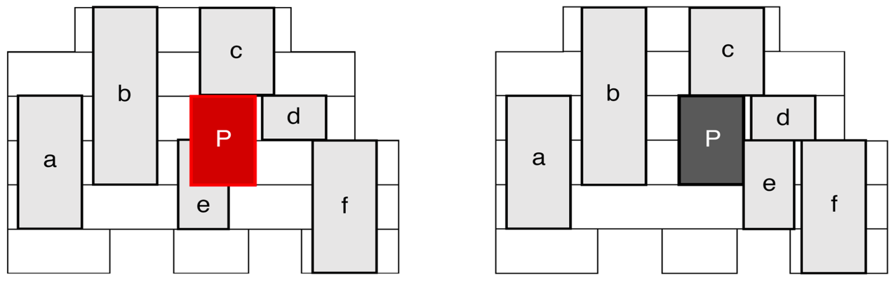
Local shifting – an example
Set a region around violating cell + rearrange peripheral cells to resolve violation
Allowed cells
Disallowed cells
Define region (clip) around violating cell
Re-arrange peripheral cells

Slide 35
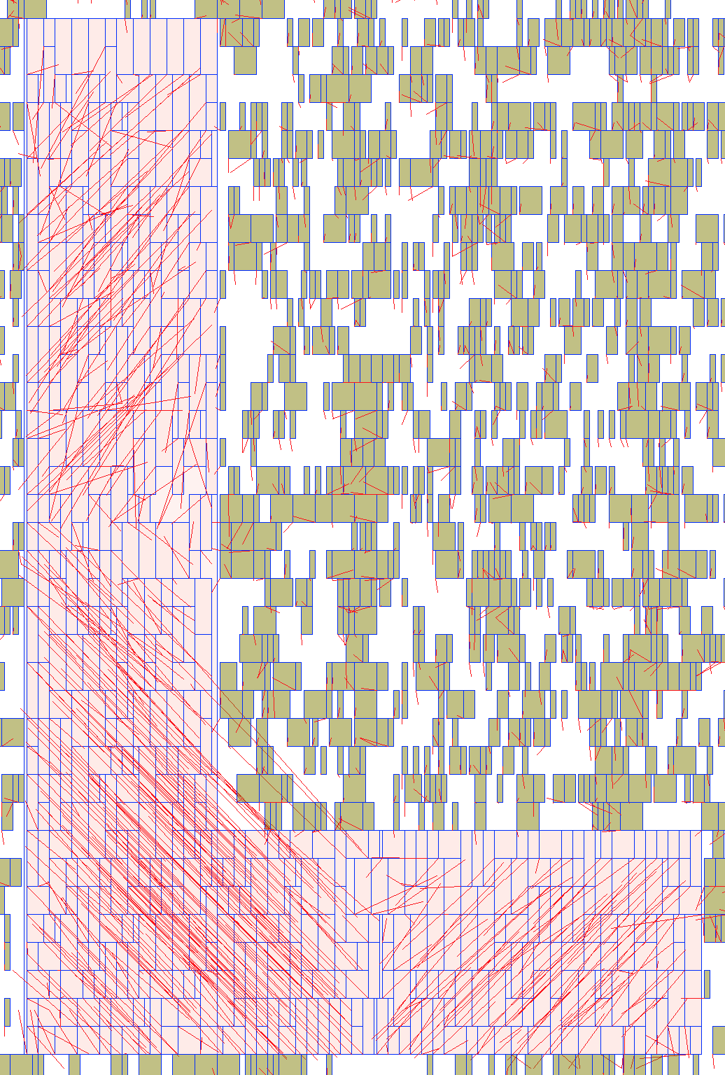
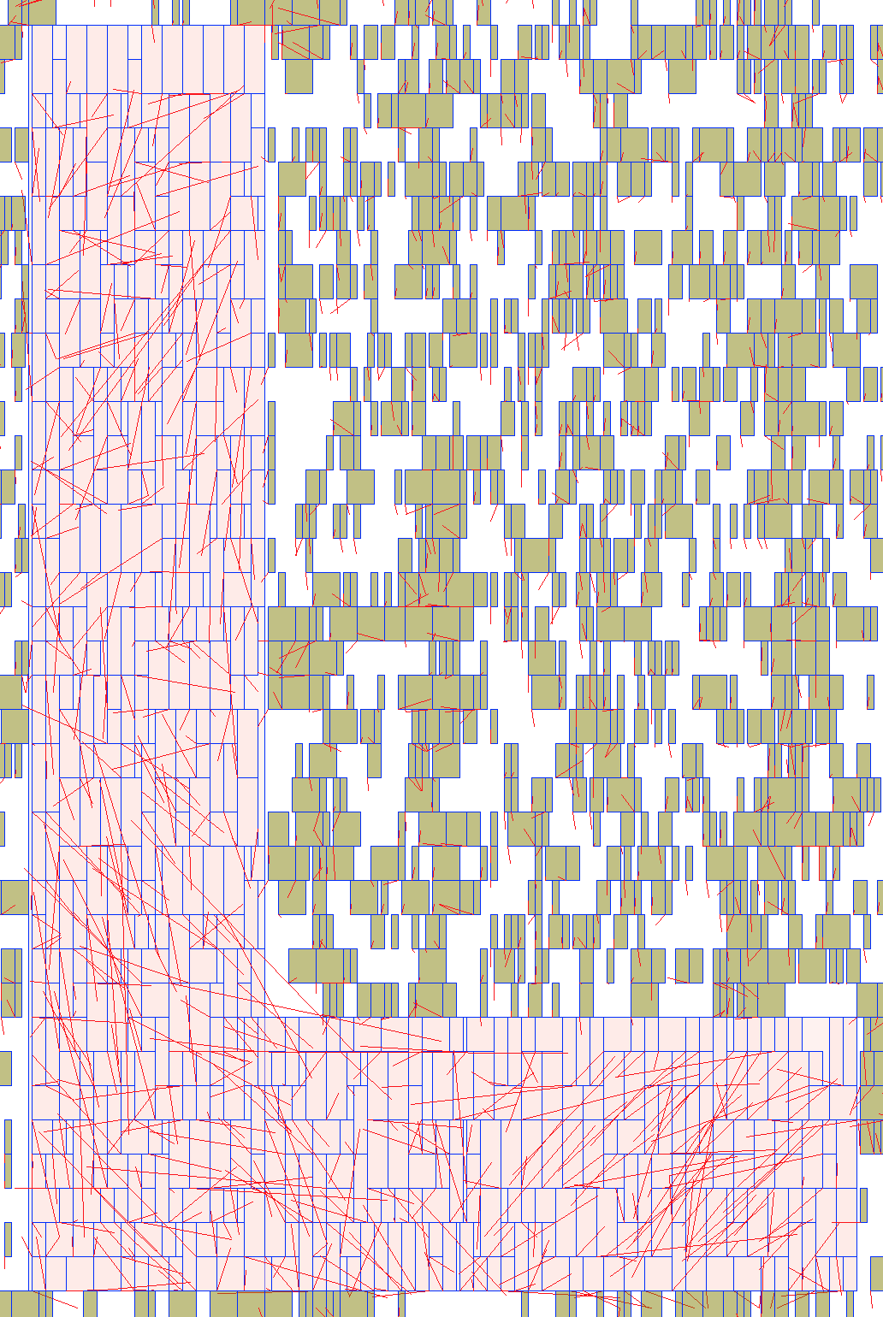
Cell swaps – an example
Before swap
After swap
Benchmark : des_perf_b_md2. Cell count : 112644. Max cell row : 4 Fence Utilization : 96.2%
Thanks: Sang-Gi Do, Samsung

Slide 36
DPO
Kahng ECE 260C SP25

Slide 37
DPO in a nutshell (1/2)
DPO runs a detailed placement “script” that can perform a sequence of different optimization algorithms (see Optdp.cpp).
Implemented algorithms (variations of what’s been described in literature as there are many incarnations of the different algorithms): Maximum independent set matching [1], Optimal reordering [2], Median improvement (global and vertical swapping) [3], greedy improvement [4]
Sample script string:
algorithm to run (e.g., gs = global swap, ro = optimal reordering, etc.)
dtParams.script_ = “mis –p 10 –t 0.005’ gs –p 10 –t 0.005 ; vs –p 10 –t 0.005; ro –p 10 –t 0.005; default –p 5 –f 20 –gen rng –obj hpwl –cost (hpwl)”
Dpo::Detailed dt(dtParams);
dt.improve(mgr);
runs the script
algorithm-specific parameters
Kahng ECE 260C SP25
Thanks: Andrew Kennings, Altera

Slide 38
DPO in a nutshell (2/2)
Most algorithms can optimize hpwl or displacement (other objectives such as timing, congestion, etc.) are not well accounted for which is a “consequence” of the algorithm.
The greedy algorithm is actually very flexible; it uses the idea of “move generators” and “cost objects” that can propose any set of cell movements (cells assigned to new locations) which are then evaluated by the “cost objects” to form a cost function.
Proposed moves are accepted or rejected based on cost and move generators and cost objects track the current state of the placement (for incremental computation).
Need to be careful to support the required object pieces to add something; e.g., routines need accept() and reject() methods.
DPO is largely not great with multi-height cells
E.g., greedy algorithm can only do simple swaps and moves and is not good at “shifting other cells out of the way”.
Kahng ECE 260C SP25
Thanks: Andrew Kennings, Altera

Slide 39
Some References
K. Doll, F. M. Johannes, and K. J. Antreich. “Iterative placement improvement by network flow methods”, IEEE Trans. Computer-Aided Design of Integrated Circuits and Systems, 13(10):1189-1200, 1994
A. E. Caldwell, A. B. Kahng and I. L. Markov, “Optimal partitioners and end-case placers for standard-cell layout”, Proc. ACM Intl. Symp. on Physical Design, April 1999, pp. 90-96.
Min Pan, Natarajan Viswanathan and Chris Chu, “An efficient and effective detailed placement algorithm”, IEEE/ACM International Conference on Computer-Aided Design, pages 48-55, 2005.
Andrew A. Kennings, Nima Karimpour Darav, Laleh Behjat “Detailed placement accounting for technology constraints VLSI-SoC 2014:1-6
Kahng ECE 260C SP25

Slide 40
BACKUP
Kahng ECE 260C SP25

